Slide 1
YOUTUBE DATA HARVESTING AND WAREHOUSING

Slide 2
OBJECTIVE
The primary objective of this project is to develop a comprehensive YouTube Data Harvesting and Warehousing solution. This involves extracting and transforming YouTube channel and video data, creating a structured relational database to store this information, and implementing an intuitive and interactive Streamlit dashboard for data analysis and querying.

Slide 3
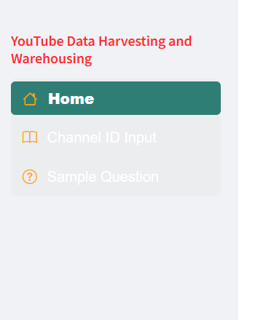
How to use it:
Here given option menu in streamlit sidebar
1.Home
2.Channel ID Input
3.Sample question

Slide 4
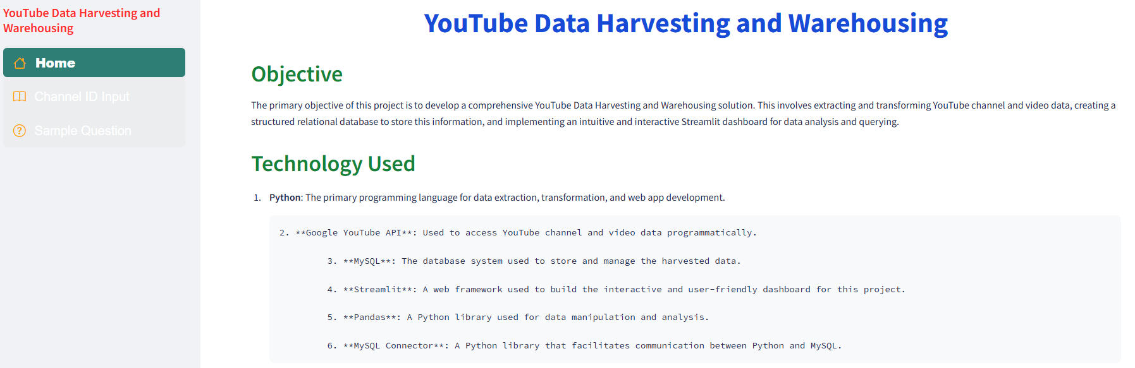
How to use it Home tape:
You click on the home tab, you can know its objective and what are technology using this project

Slide 5
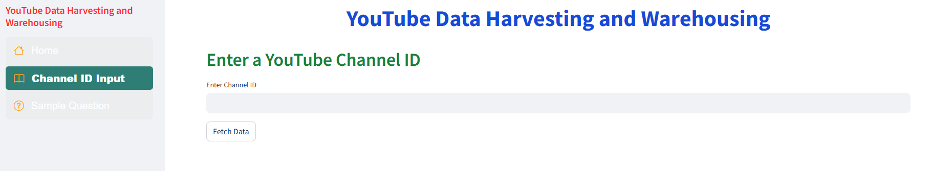
How to use it Channel ID Input tap:
Here, you are put channel id in the textbox then click on the fetch data button it will collect data from youtube that channel id like channel data, video data, comment data and the will be stored to Mysql database

Slide 6
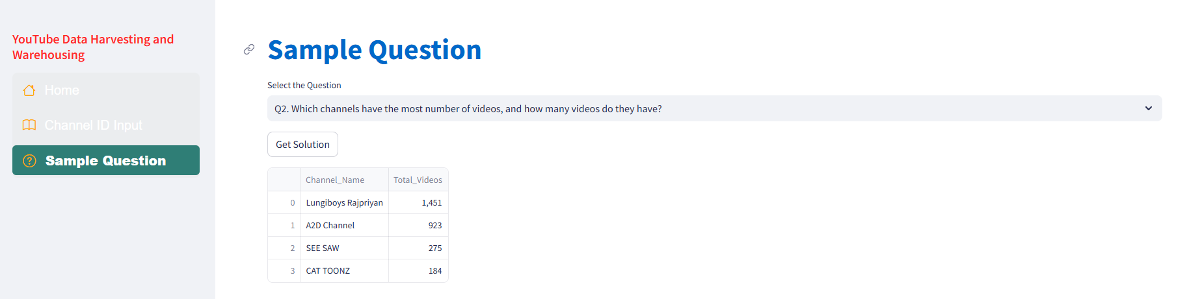
How to use it Sample Question tap:
Here give some sample questions, you are selected question on the selectbox then click on the Get solution button you are find out the channel information like how many videos does that channel have? or how many likes or comments the particular videos have? For your analysis

Slide 7
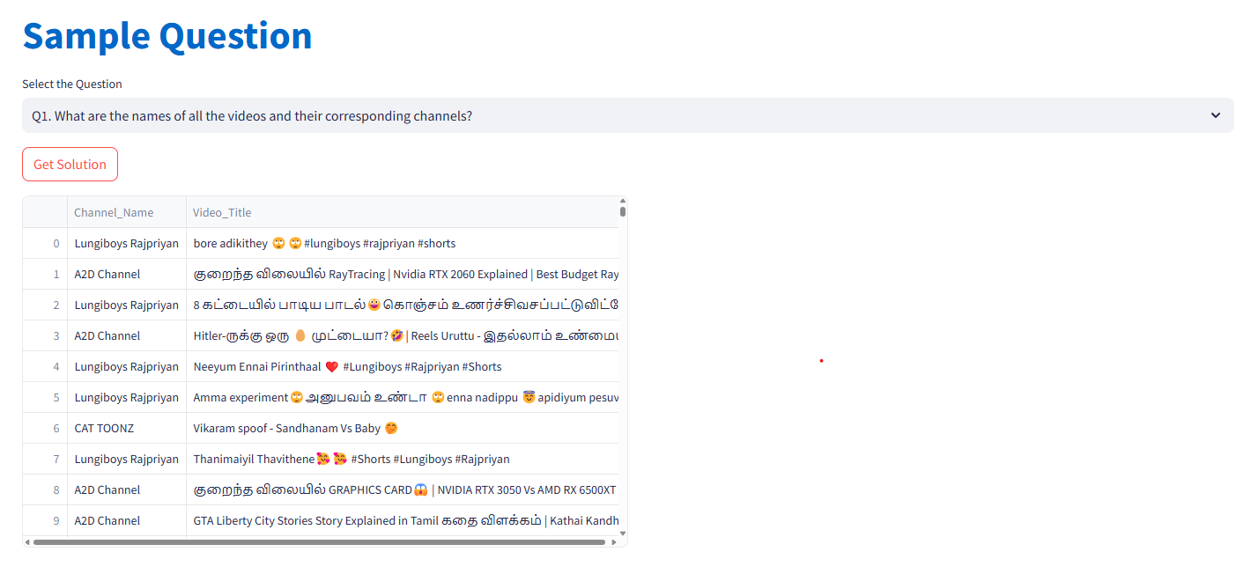
The question on the page is about finding the names of all the videos and their corresponding channels.

Slide 8
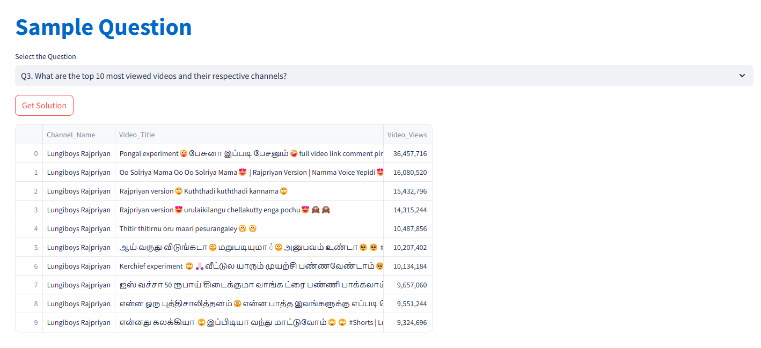
The question on the page is about finding the top 10 most viewed videos and their respective channels on a platform. The table lists the channel name, video title, and the number of views the video has.

